Slide 1

How Lambeth Council are using data to inform their current strategy on reducing violence
Cllr Jack Hopkins, Leader of Lambeth Council

Slide 2
Invest in data from the start
Be prepared to invest in data and intelligence before delivery
Challenge assumptions and basic facts
Notes:
Challenging assumptions- in Lambeth, violent crime figures have been on a downward trend since 2017, but the crimes have become considerably more violent.
Challenge basic facts- we believed that there was a link between poverty and being a victim of serious youth violence, but we had to analyse this data before we could commit to using it.

Slide 3
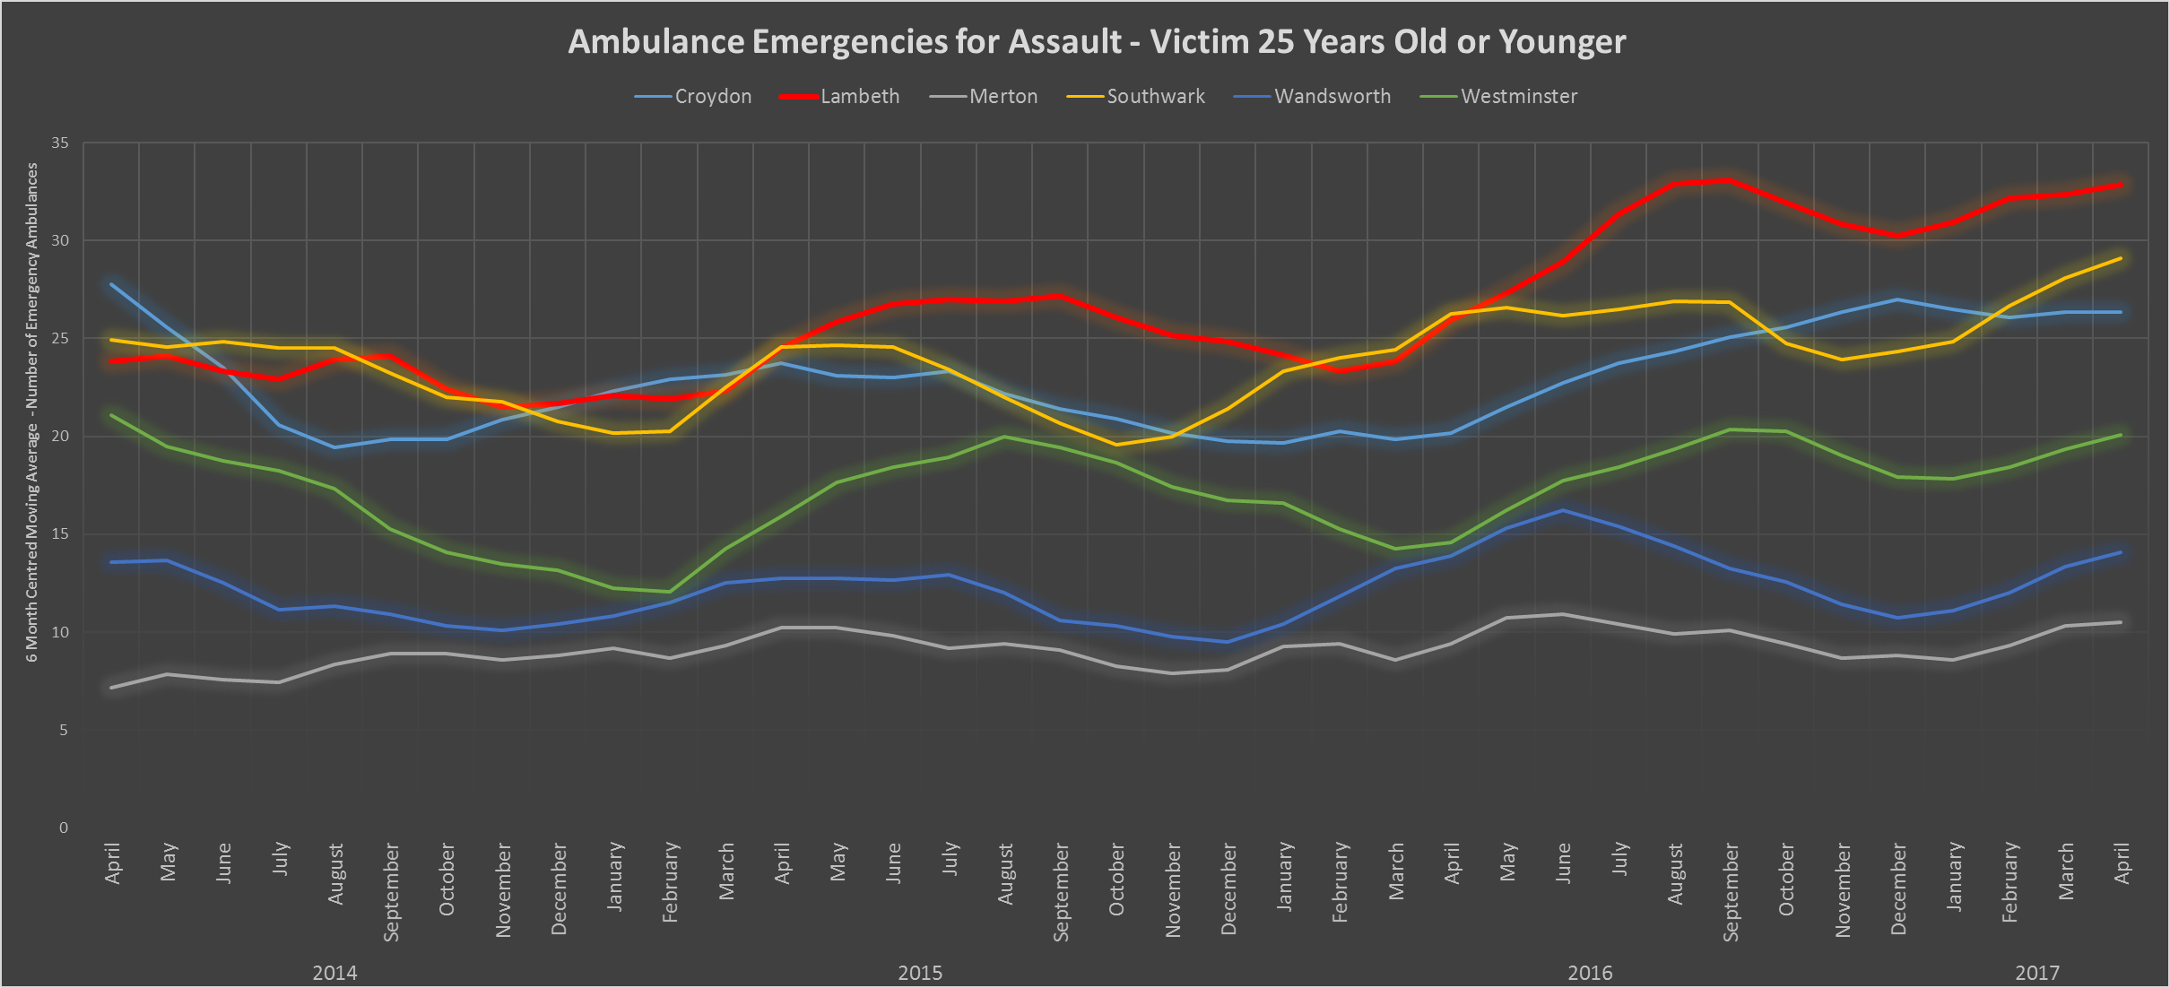
Combining data sources
Notes:
You can only get an understanding of the issue by broadening your data sources, in particular partners and other agencies who experience the issue differently. This is hard because of data protection, different organisational structures and ways of measuring things, but essential to fully comprehend what you are dealing with.
Only by combining hospital data do we get a true picture of SYV in Lambeth. Although it has been falling fast, what remains is actually more violent than ever before. Over 60% of young people admissions into hospital are for knife wounds, which tells us that the issue of SYV has changed in Lambeth and what we do to combat it has to change as well.

Slide 4
Evidence for what works
Don't rely on previous interventions
"wide and shallow" - lots of work had been done, but very little conclusive results. Projects that worked well in some areas failed in others, most didn't have evidence based outcomes built in from the start, and many relied on basic assumptions that turned out to not be true.
Notes:
don't rely on previous interventions, be prepared to challenge the fundamentals. Public Health spent 6 months creating a needs assessment that looked at what was working elsewhere, with their summary being that the evidence base was "wide and shallow" - lots of work had been done, but very little conclusive results. Projects that worked well in some areas failed in others, most didn't have evidence based outcomes built in from the start, and many relied on basic assumptions that turned out to not be true.

Slide 5
Interventions
Gang
Matrix
YOS
Detention &
Training
Order
Parental
Orders
Education
Training
Employment
Officer
Referral
Order
Speech &
Language
Therapy
Social Care
Conditional
Tag
Risk
Management
Plan
Mental
Health
Assessment
HAMPTON
Project
Looked
After
Child
SEAL
Programme
Youth
Rehab
Order
Educational
Psychology
Prison
YOUNG &
SAFE
Referral
Vulnerability
Management
Plan
GP
Medical
Assessment
Criminal
Justice
System
Lambeth
Living/
Housing
Post
Custody
Licence
Programme
Educational
Health
Assessment
Police
Substance
Misuse
Referral
Young
Offender
Institutions
Notes:
Example- individual who came to our attention early, received multiple services, still had failed life chances despite hundreds of thousands of pounds of services all of which were designed to help someone like this. This isn't that the services were bad - but they weren't able to help someone like this, and we needed to take a fundamental look at what we were doing and how effective it was.
Came to notice of social care as a young child
Absent dad
History of Domestic Violence in the home
Mother unable to set appropriate boundaries
Siblings linked to crime and gangs
Excluded from mainstream education
Learning and educational difficulties
Gang affiliated
Offending linked to local area and estates
First convicted before the age of 18
He has been in an out of prison 7 times, being shot at and being expected in court for further trials.

Slide 6
Consider data at every stage
Don't just start with evidence, but built it into every stage of you work.
Circumstances on the ground can change very rapidly in this field, so you can't rely on just doing a big data project at the start.
Notes:
Don't just start with evidence, but built it into every stage of you work. You need to think about how continued use of intelligence and data will help your projects, and what mechanisms there are for that. Circumstances on the ground can change very rapidly in this field, so you can't rely on just doing a big data project at the start.
Example: As well as the multiple delivery workstreams, we created a separate, Public Health led workstream that supports the entire program. This continually looks at the data we use and how we are suing it, and is trialling new ways of working and combining data to improve our results. By building this into the structure as a discrete element, it ensures we can adapt and improve our data use throughout the life of the programme. Also means we can build in evdience based outcome measurement from the start, including independant analysis of success, rather than relying on individual projects to do so in a haphazard fashion.

Slide 7
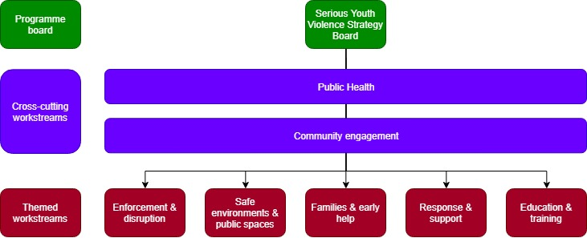
Review your approach
Notes:
Don't be afraid to change your approach. We used the WHO "Inspire" model for tackling violence against children as the academic underpinnings for our strategy. and we built the programme around that - rather than around our existing structures and systems as we normally would do. This is more challenging than a normal program, but gives us a clearer structure for delivery that is backed by an existing broad academic framework.

Slide 8
Challenges
How do you use community intelligence?
What is real versus what is believed?
How do you use data and intelligence to change your project in mid term?
Notes:
Interactive:
- How do you use community intelligence? Our communities know more about issues than we can ever learn from numbers and stats, how do we enable that to inform our work?
(Example: Someone was shot leaving a residential flat in a targetted attack in South Norwood last year. All the residents knew that the flat they were staying in was a trap house, and routinely targetted, but we didn't and they didn't know how to tell us safely. Had we known, we could have prevented the shooting)
- What is real versus what is believed? More than any other field, what people think they know about crime and disorder can be very different to what is real about crime and disorder. You need to think not just about how you determine this, but also how you then challenge and communicate those messages (See earlier example of levels of SYV in Lambeth).
- How do you use data and intelligence to change your project in mid term? We often start projects in a wealth of data, but that is seen as a one off investment and is rarely updated and changed. You need to think about how you build data structures into everyday work, and how you give your projects the space and time to be able to update their data and constantly challenge assumptions in a rapidly changing field.

